Slide 1
Input-Process-Output Framework
Arthur S. Abulencia
Professor, GS 222

Slide 2
Inputs
The resources that groups have at their disposal and are generally divided into three categories: individual-level factors, group-level factors, and environmental factors.
Individual-level factors = personal motivation, personality, abilities, experiences, and demographic attributes.

Slide 3
Inputs
Group-level factors = work structure, team norms, and group size.
Environmental factors = reward structure, stress level, task characteristics, and organizational culture.

Slide 4
Processes
The mediating mechanisms that convert inputs to outputs.
Processes represent interactions that take place among team members.
In company, different teamwork behaviors have been proposed like coordination, communication, conflict management, and motivation.

Slide 5
Process
In comparison with inputs and outputs, group processes are often more difficult to measure, because a thorough understanding of what groups are doing and how they complete their work may require observing members while they actually perform a task.
This may lead to a more accurate reflection of the true group processes, as opposed to relying on members to self-report their processes retrospectively.
In addition, group processes evolve over time, which means that they cannot be adequately represented through a single observation.

Slide 6
Process
These difficult methodological issues have caused many studies to ignore processes and focus only on inputs and outputs.
Empirical group research has therefore been criticized as treating processes as a “black box” (loosely specified and unmeasured)
Recently, a number of researchers have given renewed emphasis to the importance of capturing team member interactions, emphasizing the need to measure processes longitudinally and with more sophisticated measures.

Slide 7
Outputs
Indicators of team effectiveness have generally been clustered into two general categories: group performance and member reactions.
Group performance refers to the degree to which the group achieves the standard set by the users of its output.
Examples include quality, quantity, timeliness, efficiency, and costs. In contrast, member reactions involve perceptions of satisfaction with group functioning, team viability, and personal development.

Slide 8
Outputs
For example, although the group may have been able to produce a high-quality product, mutual antagonism may be so high that members would prefer not to work with one another on future projects.
In addition, some groups contribute to member well-being and growth, whereas others block individual development and hinder personal needs from being met.

Slide 9
Outputs
Both categories of outcomes are clearly important, but performance outcomes are especially valued in the teams literature.
This is because they can be measured more objectively (because they do not rely on team member self-reports) and make a strong case that inputs and processes affect the bottom line of group effectiveness.

Slide 10
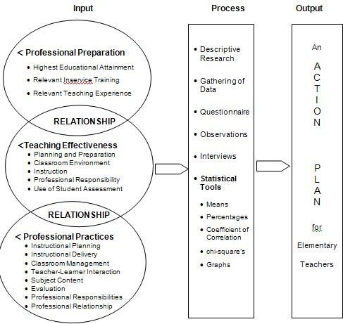

Slide 11
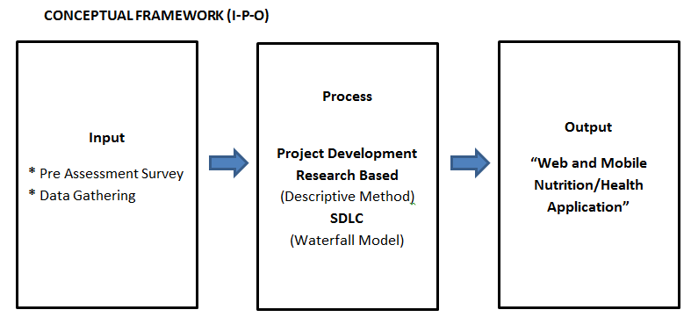

Slide 12
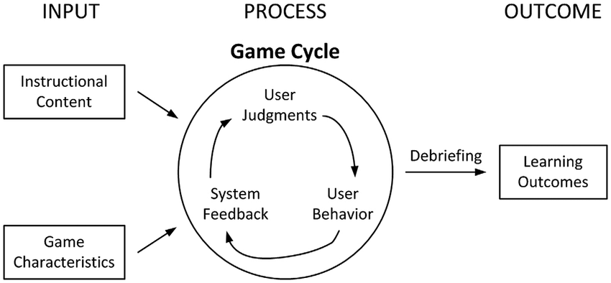

Slide 13
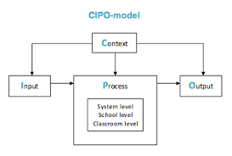
IPO with Context

Slide 14
INPUTS | PROCESSES | OUTPUTS
-Professors who know how speak Chinese -Technology (e.g. internet, laptop etc) Experience of MA students Agent (company) Money | -JRU will consult with Chinese students, parents, professors | Curricular Program (Online MA Program for Chinese Students) of JRU

